Slide 1
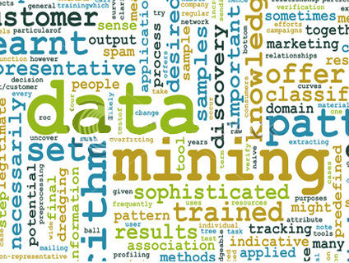

SFO Airport customer survey data clustering Discovering knowledge in database, term project
Prof. M. Daneshmand,
Accomplished by: Mohsen Mosleh

Slide 2






Topics
Problem statement (Business understanding Phase)
Data (Data Understanding)
Methodology (Data Preparation, Modeling)
Software
Execution and analysis (Evaluation and Deployment)
References

Slide 3
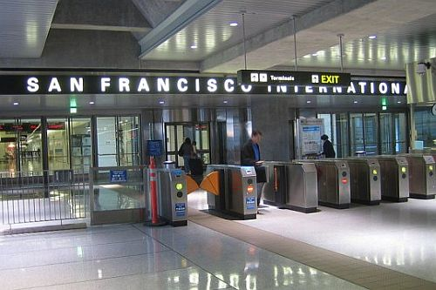
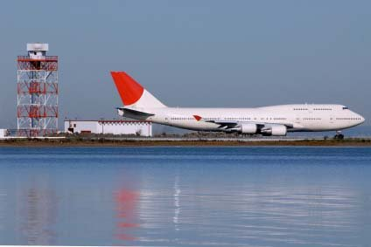
Problem statement - Business understanding
San Francisco International Airport (SFO), a department of the City and County of San Francisco, is a transparent organization dedicated to serving the local community as well as the millions of travelers who pass through its doors each year.
SFO is committed to setting the standard for the industry. This includes being a leader in safety and security, customer service and satisfaction, community relations, environmental commitment, quality of facilities, and financial and economic vitality.

Slide 4
Problem statement – Profound question
The SFO stakeholders would like to create profiles of travelers based on their importance and usage of the airport. The stakeholders would use this information for development of marketing campaign, communication to airlines and comprehend the travellers’ decision-making process
Profound question:
What are the groups of customers with the most similar attributes with respect to the captured value from customer.
Note: value that customer add to a business is a function of the total purchases she makes to a business

Slide 5

Data understanding
The passenger datasets contain data pertaining to customer demographics and satisfaction with Airport facilities, services, and initiatives. The current data was collected in May 2011 through interviews with 3,872 customers in each of SFO’s terminals and boarding areas. Samples sizes per terminal, boarding area, airline, and time of day were weighted to reflect actual customer traffic disbursement.
Customers were asked to rate the Airport in 20 categories, including 6 cleanliness ratings. Additional data collected include customer spending behavior, mode of arrival to the Airport, awareness of SFO initiatives, and many other categories.
All datasets are released in Excel or Comma-Separated Value spreadsheets. All datasets have an associated data dictionary with definitions for fields in the dataset.
Number of Records= 3872
Number of attributes= 68
http://www.flysfo.com/web/page/about/news/pressres/custsurveydata.html , Accessed Nov 29 2012

Slide 6
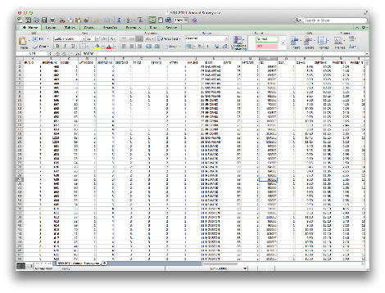
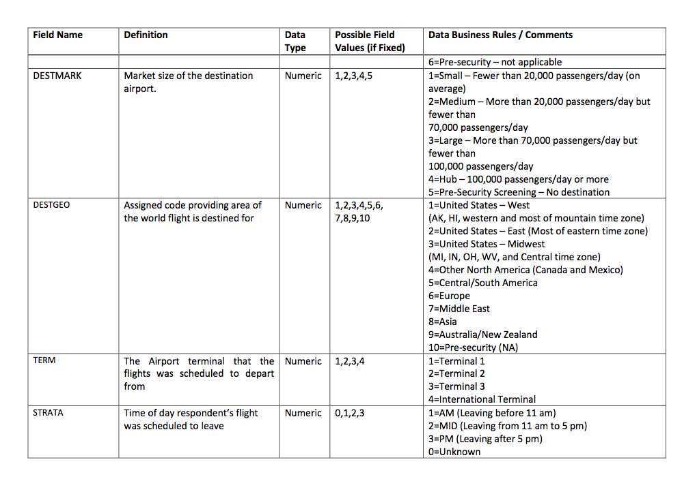
Data understanding
Data
Associated data dictionary

Slide 7
Data preparation
Among different attributes in data, the following ones are the most related to the value that customer add to a business:
Field Name | Definition | Data Type | Possible Field Values (if Fixed) | Data Business Rules / Comments
Q7 | Counting today, about how many times have you flown out of SFO in the past 12 months? | Numeric | 0,1,2,3,4,5,6 | 1=One time (just today) 2=2 times 3=3-6 times 4=7-12 times 5=13-24 times 6=More than 24 times 0=Blank
Q19 | Age | Numeric | 0,1,2,3,4,5,6, 7,8 | 1=Under 18 2=18 – 24 3=25 – 34 4=35 – 44 5=45 – 54 6=55 – 64 7=65 and over 8=Don’t know/Refused 0=Blank
Q 21 | Household Income in US Dollars | Numeric | 0,1,2,3,4,5 | 1=Under $50,000 2=$50,000-$100,000 3=$100,001-$150,000 4=Over $150,000 5=Other (unspecified) 0=Blank

Slide 8
Data preparation-cleaning
Outliers
There were no outliers since
all values fall inside the range
Missing values
Many questions were left ‘unanswered’ and many people rejected to supply information or select unspecified.
We employed the distribution of valid data and generated random number based on it for the missing data
Normalizing
The data was normalized using min-max method between 0 and 1
 | TIMES FLOWN | AGE | INCOME
Q1 | 1 | 3 | 1
Q3 | 3 | 6 | 3
IQR | 2 | 3 | 2
higher_L | -2 | -1.5 | -2
Lower_L | 6 | 10.5 | 6
Times flown
Age
Income

Slide 9
Data preparation-cleaning
Raw data
Cleaned data
Normalized data
Q7 | Q19 | Q21
2 | 5 | 3
1 | 2 | 1
1 | 7 | 0
1 | 2 | 1
3 | 5 | 0
2 | 6 | 3
2 | 4 | 2
2 | 5 | 2
1 | 5 | 2
2 | 2 | 1
3 | 6 | 3
5 | 3 | 2
1 | 5 | 2
2 | 6 | 0
1 | 4 | 3
2 | 4 | 1
1 | 3 | 1
2 | 6 | 1
Q7_SUB | Q19_SUB | Q21_SUB
2 | 5 | 3
1 | 2 | 1
1 | 7 | 2
1 | 2 | 1
3 | 5 | 2
2 | 6 | 3
2 | 4 | 2
2 | 5 | 2
1 | 5 | 2
2 | 2 | 1
3 | 6 | 3
5 | 3 | 2
1 | 5 | 2
2 | 6 | 3
1 | 4 | 3
2 | 4 | 1
1 | 3 | 1
2 | 6 | 1
Q7_Norm | Q19_Norm | Q21_Norm
0.2 | 0.67 | 0.67
0 | 0.17 | 0.00
0 | 1.00 | 0.33
0 | 0.17 | 0.00
0.4 | 0.67 | 0.33
0.2 | 0.83 | 0.67
0.2 | 0.50 | 0.33
0.2 | 0.67 | 0.33
0 | 0.67 | 0.33
0.2 | 0.17 | 0.00
0.4 | 0.83 | 0.67
0.8 | 0.33 | 0.33
0 | 0.67 | 0.33
0.2 | 0.83 | 0.67
0 | 0.50 | 0.67
0.2 | 0.50 | 0.00
0 | 0.33 | 0.00
0.2 | 0.83 | 0.00
1. The relevant attributes were extracted from the datasheet
2 . The unanswered items where substituted by random number based on the distribution
3 . Using min-max method, the data were normalized

Slide 10
Methodology-Algorithm
K-means clustering was selected as the data mining algorithm.
Why clustering?
For a successful business, identification of high-profit, low-risk customers, retaining those customers and bring the next level customers to above cluster is a key tasks for business owners and marketers. … marketers must first identify customer cluster using a mathematical model and then implement an efficient campaign plan to target profitable customers
Data mining techniques like clustering can be used to find meaningful patterns for future predictions. Customer clustering is one of the most important techniques used in marketing and.
Rajagopal, Dr. "Customer Data Clustering using Data Mining Technique, 2011

Slide 11

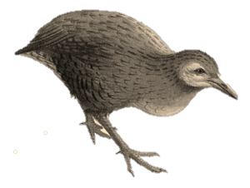
Methodology-Software
Weka is a collection of machine learning algorithms for data mining tasks. The algorithms can either be applied directly to a dataset or called from your own Java code. Weka contains tools for data pre-processing, classification, regression, clustering, association rules, and visualization. It is also well-suited for developing new machine learning schemes.

Slide 12
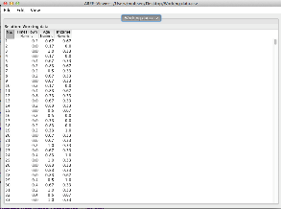
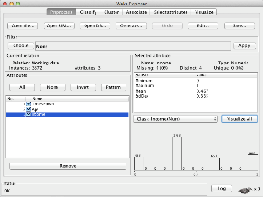
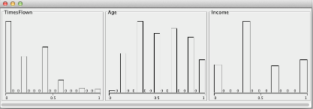
Execution and analysis- Importing data
Importing data into Weka
After data cleansing and normalizing data were imported in to Weka
A list of imported instances into Weka
Selecting items to work on in Weka
Distribution of imported data into Weka

Slide 13
Execution and analysis – finding K
The correct choice of k is often ambiguous and depends on the shape and scale of the distribution of points in a data set and the desired clustering resolution of the user.
Increasing k without penalty will always reduce the amount of error in the resulting clustering.
The optimal choice of k will strike a balance between maximum compression of the data using a single cluster, and maximum accuracy by assigning each data point to its own cluster.
K=4 was chosen based on the insubstantial decrease in SSE in higher cluster number and user resolution
http://en.wikipedia.org/wiki/Determining_the_number_of_clusters_in_a_data_set , Accessed Dec 16 2012

Slide 14
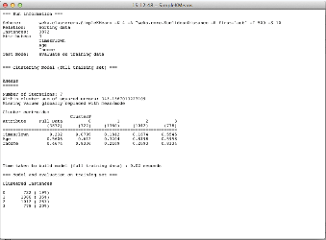
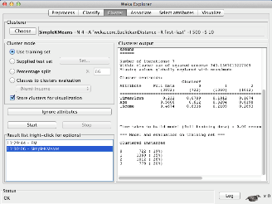
Execution and analysis – result
The result of clustering for k=4
weka.clusterers.SimpleKMeans -N 4 -A "weka.core.EuclideanDistance -R first-last" -I 500 -S 10
Number of iterations: 7
SSE: 343
Number of instances: 3872
Attributes: TimesFlown, Income, Age
Cluster centroids:
Attributes | Full data | Cluster0 | Cluster1 | Cluster 2 | Cluster 3
 | 3872(100%) | 722(19%) | 1360(35%) | 1012(26%) | 778(20%)
Times Flown | 0.232 | 0.0709 | 0.1812 | 0.1674 | 0.5545
Age | 0.5606 | 0.612 | 0.3204 | 0.8198 | 0.5958
Income | 0.4674 | 0.8336 | 0.2109 | 0.2693 | 0.8334

Slide 15
Execution and analysis – Analyzing clusters’ characteristics
Cluster centroids are the mean vectors for each cluster (so, each dimension value in the centroid represents the mean value for that dimension in the cluster). Thus, centroids can be used to characterize the clusters
 | Average number of times flown in a year | Average age | Average income
Cluster 0 | 1 | 45-54 | 100,000-over 150,000
Cluster 1 | 2 | 25-34 | 50,000-100,000
Cluster 2 | 2 | 55-64 | 50,000-100,000
Cluster 3 | 7-12 | 40-50 | 100,000-over 150,000
http://facweb.cs.depaul.edu/mobasher/classes/ect584/

Slide 16
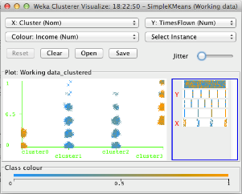
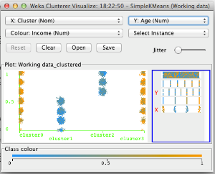
Execution and analysis – Analyzing clusters’ characteristics
Another way of understanding the characteristics of each cluster in through visualization. One can choose the cluster number and any of the other attributes for each of the three different dimensions available (x-axis, y-axis, and color). Different combinations of choices will result in a visual rendering of different relationships within each cluster.
X: Cluster No. Y: Times Flown Color: Income
X: Cluster No. Y: Age Color: Income

Slide 17
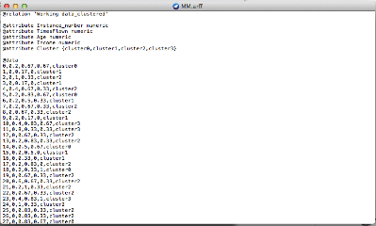
Execution and analysis – Conclusion
This study uses demographic and spending behavior for customer clustering. The final results demonstrate that the proposed approach revealed the high-value customers. From the results, cluster 3 has high value customers and represents about 20% percent of the interviewees.
Using the result of this study, stakeholders can take more effective strategy toward retaining each group of customers.
The result of clustering Algorithm,

Slide 18
References
[1] Rajagopal, Dr. "Customer Data Clustering using Data Mining Technique." arXiv preprint arXiv:1112.2663 (2011).
[2] Wikipedia
[3] http://facweb.cs.depaul.edu/mobasher/classes/ect584/
[4] http://www.flysfo.com/web/page/about/news/pressres/custsurveydata.html
[5] Lecture notes

